Slide 1
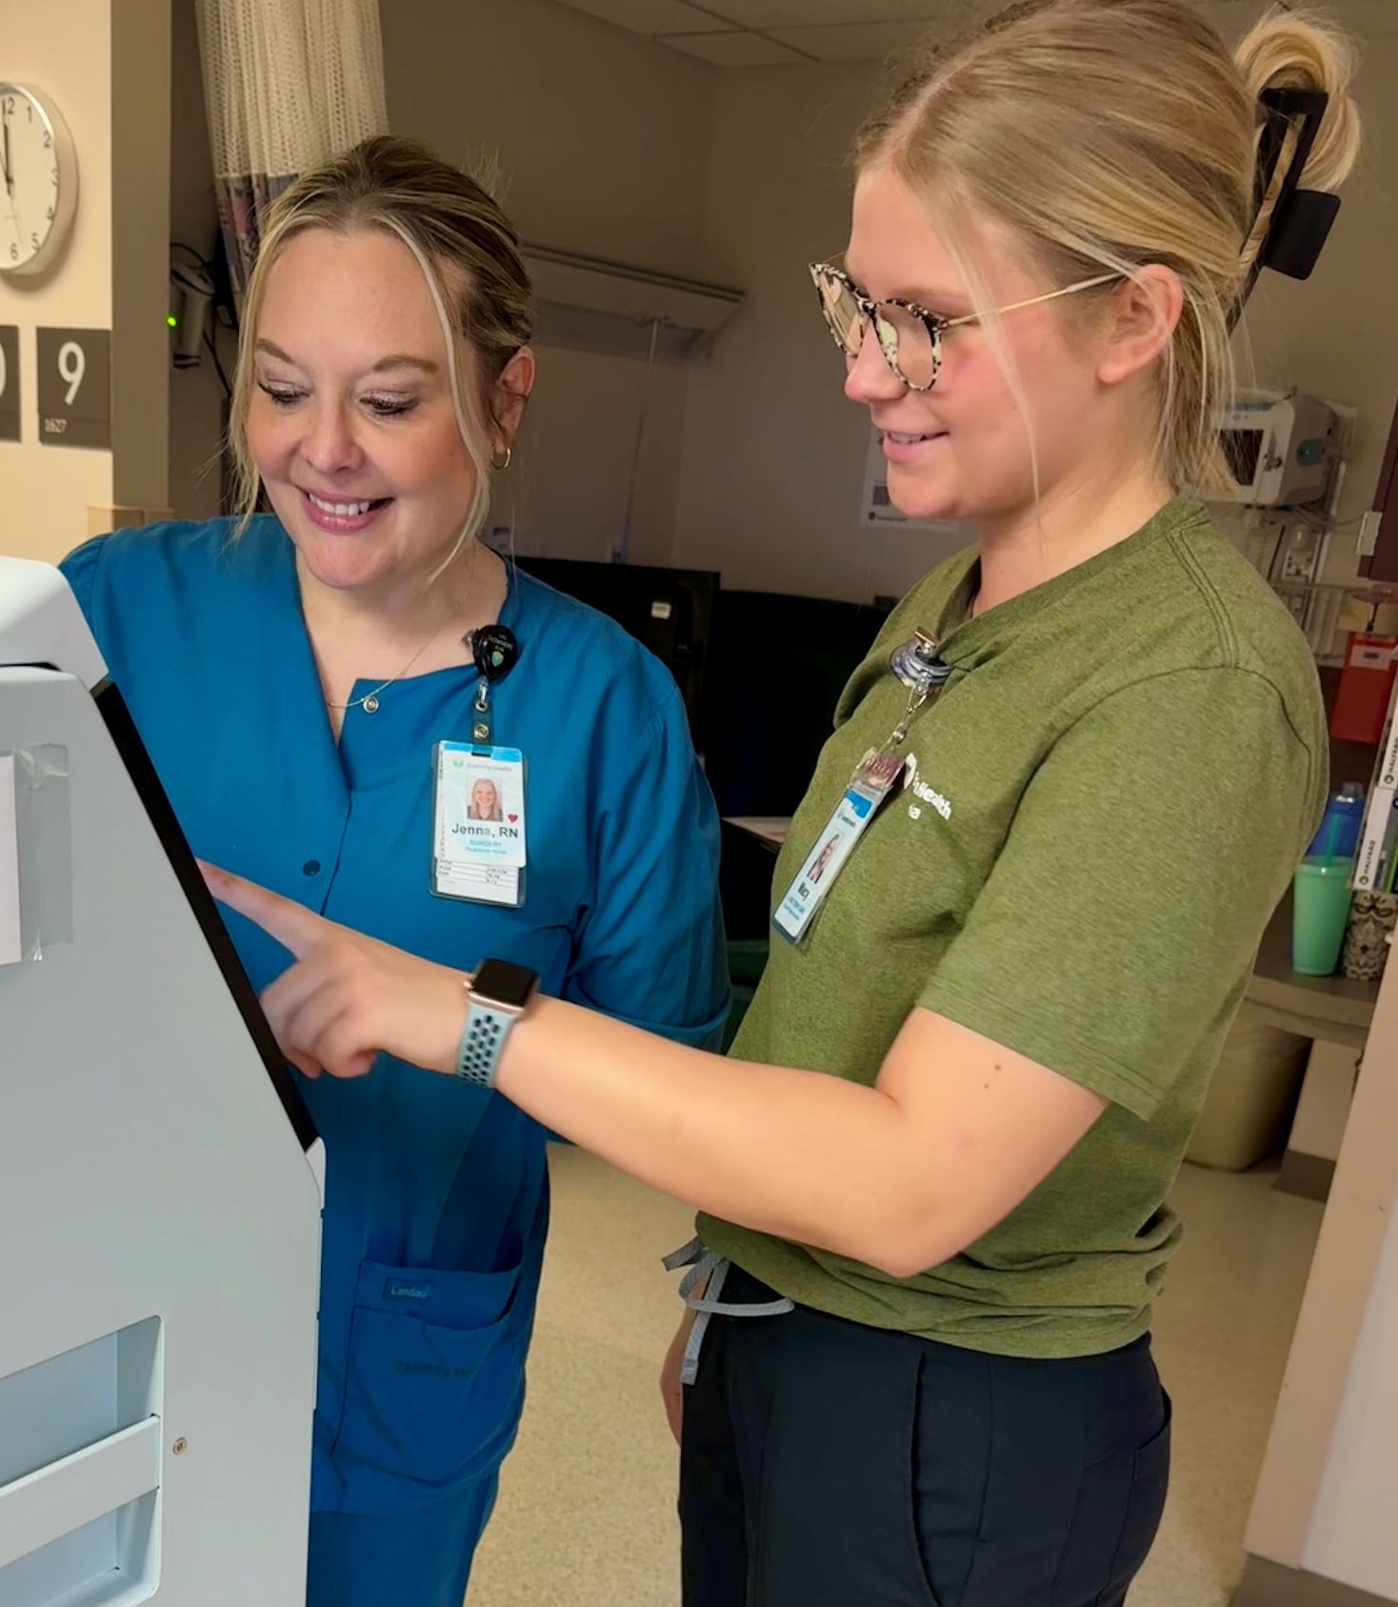
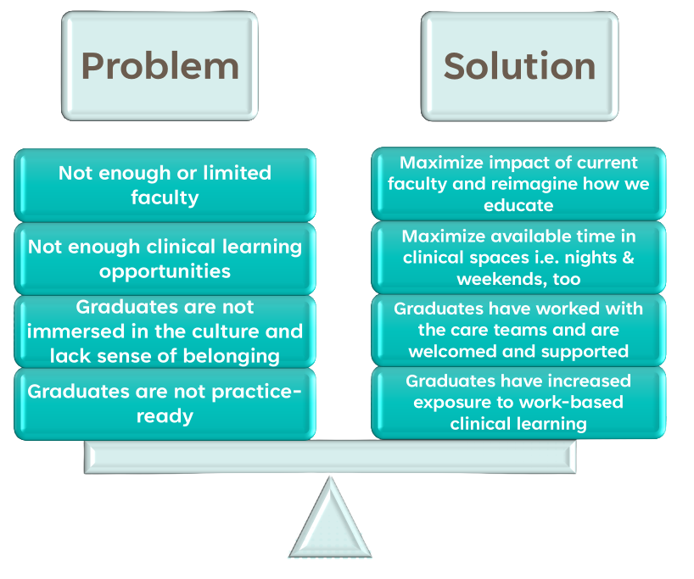
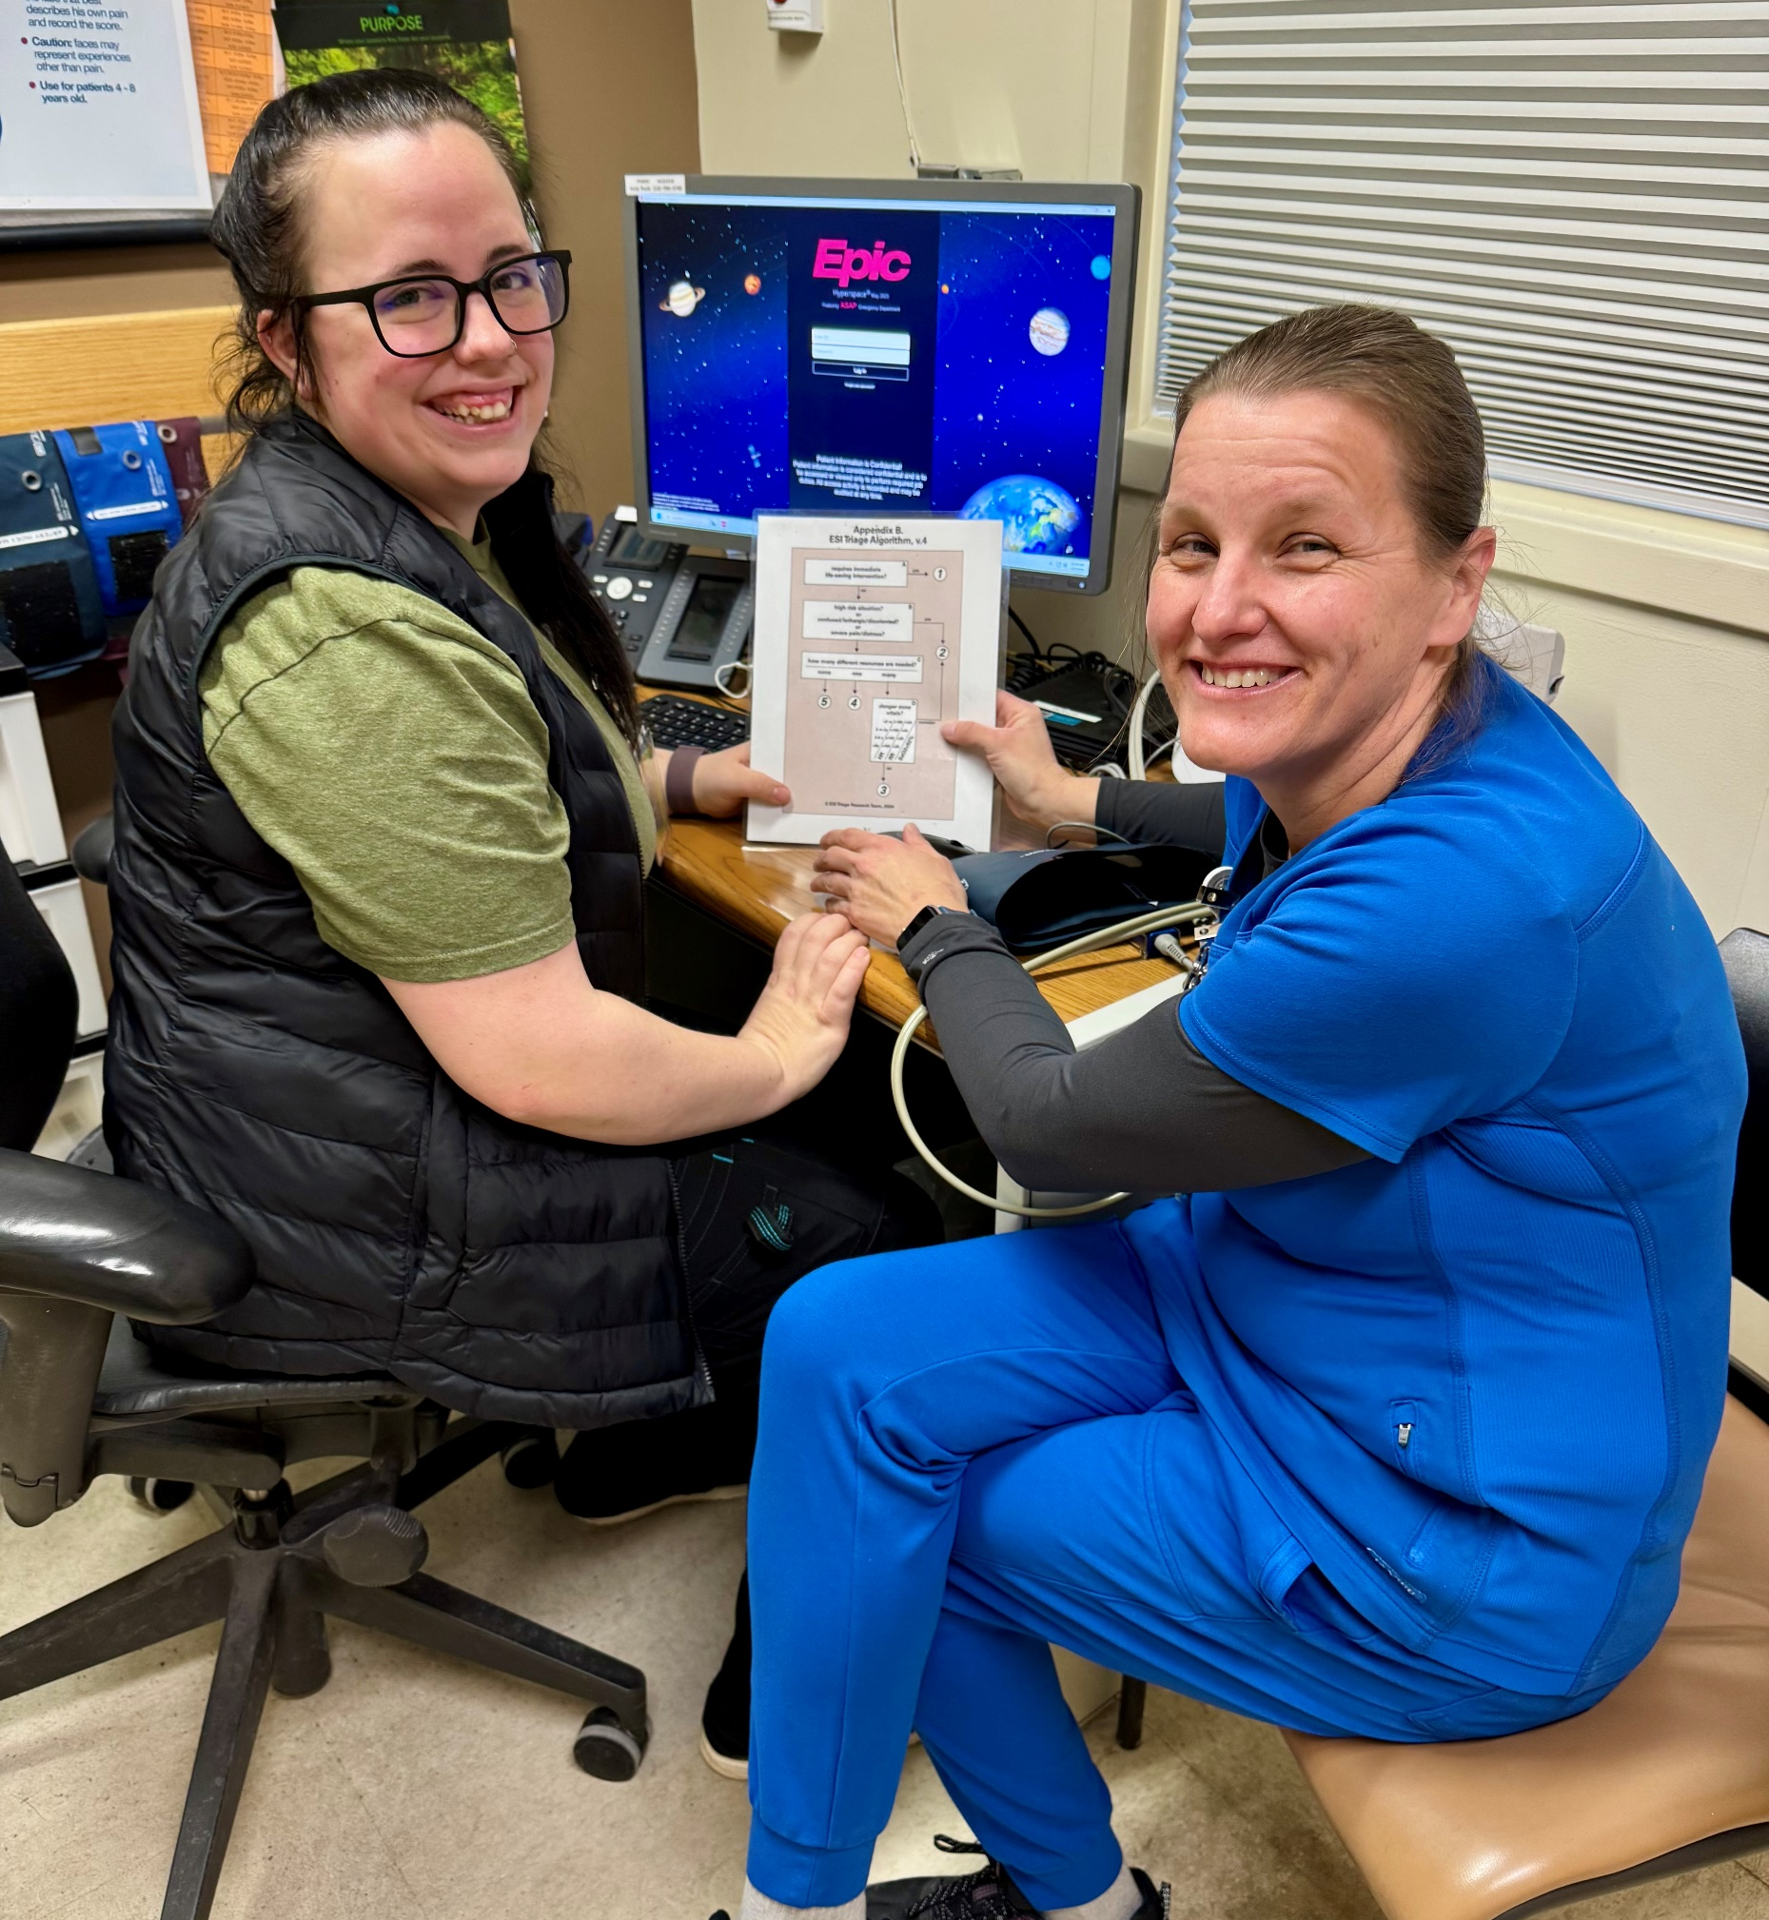
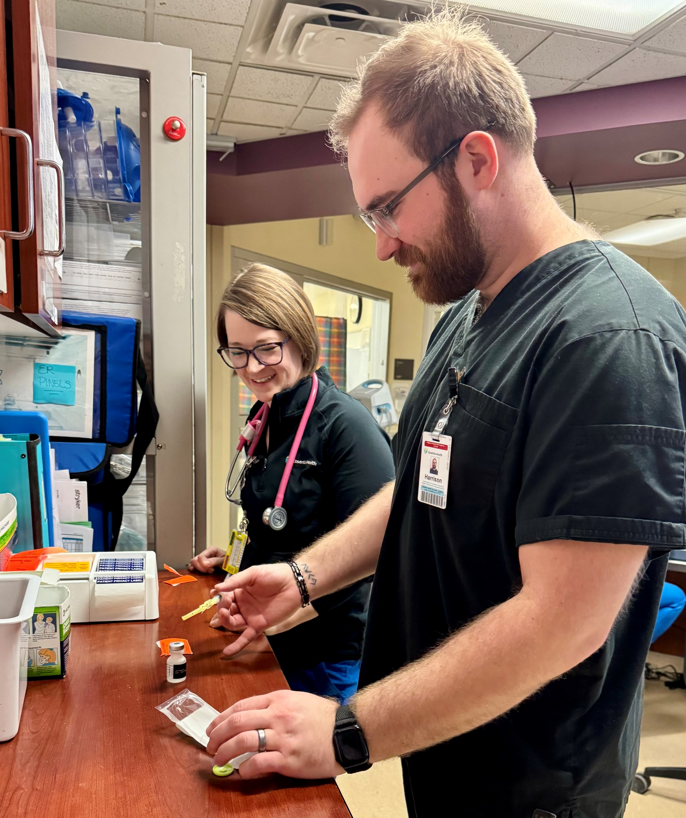





Paid Pre-Licensure Nurse Apprenticeship: A Model for Workforce Stability Julie Anderson PhD, RN Jennifer Eccles PhD, MSN, MEd, RN, FAADN Lynette How, MSN, BAN, BFA, RN Carolyn Hughes, DNP, RN, PHN, NE-BC, NPD-BC
Background
Outcomes
Application to Other Settings
The U.S. nursing workforce continues to face challenges in recruiting, retaining, and preparing a practice‑ready pipeline
Challenges are especially noted in rural health, long term care, post-acute and community health settings
Employers face longstanding nursing vacancies, increased turnover, and increased onboarding costs for new nurses
A collaborative solution was needed to expand access, reduce barriers, and strengthen workforce readiness
100% NCLEX‑RN® success among apprentice graduates
Zero vacancy in historically hard‑to‑fill positions
50–75% reduction in orientation time
Scalable for:
LPN, ADN, BSN and Post-Baccalaureate programs
Implementation in acute, specialty, post‑acute, long-term care, critical access, rural health, and all diverse healthcare environments
Program Overview
The paid Pre-licensure Nursing Apprenticeship Model (PNAM) is a structured, earn‑as‑you‑learn model
Apprentices receive:
3 days/week paid or forgivable loan academic release time
2 days/week paid supervised clinical experience
Access to all nursing professional development and learning opportunities the employer offers
Wrap-around support through the program navigators, such as twice monthly meetings to address any needs (financial, social, emotional, cultural, etc.) which may impact success
Employers receive:
Commitment of one year of RN employment after apprentice graduation and NCLEX passage
Linn, K. (2026). Macy Westby, RN Apprentice and Jenna Adams, RN
“I really like the PNAM experience – I feel like I am getting ‘so much more’ out of
my clinical time. I’m learning so much!”
~ Current Apprentice
Impact
Increased confidence in clinical decision‑making and professional identity formation
Stronger cultural integration
Reduced financial, social, and academic barriers to becoming a nurse
Meaningful partnerships between academia and employers to prepare highly skilled and practice-ready nurses
Reduced experience-complexity gap
A nurtured and supported pipeline of compassionate, competent nurses
Linn, K. (2026). Thea White, RN Apprentice and Kelly Thelen, RN
Acknowledgements
Lessons Learned
MN Department of Employment and Economic Development (DEED)
The Minnesota State Health Force Center of Excellence
University of Minnesota School of Nursing
Early and continuous engagement of academic and employer partners is essential
High‑level coordination between schools and employers ensures smooth implementation
Trust‑building and clear communication channels support sustainability
Apprentices benefit from clear expectations, consistent mentorship, and structured support systems
References and Contact Info
“The apprenticeship immerses student in consistent, real-work nursing experiences on the very units they will serve, building confidence, competence, and strong clinical judgement. By the time they pass their boards, graduates are polished, unit-ready professionals who can truly hit the ground running from day one.”
Cathy Mattfield, Director of Nursing
Use the QR Code to access the refences and contact information.
Linn, K. (2026). Sarah Ellis, RN, and Harrison Reinke, RN Apprentice

